Slide 1
Risk of Crypto for Asset Owners
“Insights and Innovation”
Stephen Campisi, CFA
www.thepensargrp.com

Slide 2
Part One: The Investment Context

Slide 3
Organizational Context: Framework for Decision Making
Oversight
Investing
Risk Management
Financial Support
Financial Support
Stability
Recognition
Reputation
Mission
Identity
Goals
Methods
Hierarchy of Organizational Needs

Slide 4
Guidance on Asset Behavior “Think Functionally”
Client Monetary Goals
Growth
Diversification
Liquidity
Inflation Hedge
Alpha
Crisis Hedge

Slide 5
Guidance on Considering Any Investment
Don’t focus on what something is called;
Focus on how it behaves.

Slide 6
Demonstrating the Maxim: Downturn Example - 2008
What It’s Called
How It Behaved
Real Estate
Foreign Stocks
US Large Cap Stocks
Commodities
High Yield Bonds
Hedge Funds
Corporate Bonds
Aggregate Bonds
20-30yr Treasury STRIP
-56%
-43%
-37%
-35%
-27%
-23%
- 4%
+5%
+55%
What is the
true diversifier?

Slide 7
Demonstrating the Maxim: Recovery Example - 2009
What It’s Called
How It Behaved
Real Estate
Foreign Stocks
US Large Cap Stocks
Commodities
High Yield Bonds
Hedge Funds
Corporate Bonds
Aggregate Bonds
20-30yr Treasury STRIP
+90%
+32%
+27%
+19%
+59%
+13%
+17%
+ 6%
-36%
Significance
of these
Recoveries?

Slide 8
Demonstrating the Maxim: Two-year Outcome 2009
What It’s Called
How It Behaved
Real Estate
Foreign Stocks
US Large Cap Stocks
Commodities
High Yield Bonds
Hedge Funds
Corporate Bonds
Aggregate Bonds
20-30yr Treasury STRIP
-17%
-25%
-20%
-23%
+17%
-13%
+12%
+11%
- 1%
Comparable
Outcomes

Slide 9
Guidance on Asset Behavior “State your expectations”
Return
Volatility
Correlation to other assets
Liquidity
“RPP” - Return pattern peculiarities
Downside Risk
Skewness
Kurtosis

Slide 10
Part Two: What is this thing called “Crypto?”*
Overused pun on the 1929 song “What is this thing called love?” (Cole Porter, for the musical “Wake up and dream”)

Slide 11
The Claims of “Crypto”
Digital money: a better means of transacting
Independent of governments and financial institutions
No intermediaries involved in transferring crypto funds
Anonymous
Unalterable
Efficient
A nice article on coins and tokens:
https://blogs.cfainstitute.org/investor/2022/04/25/crypto-tokens-and-crypto-coins-what-drives-performance/

Slide 12
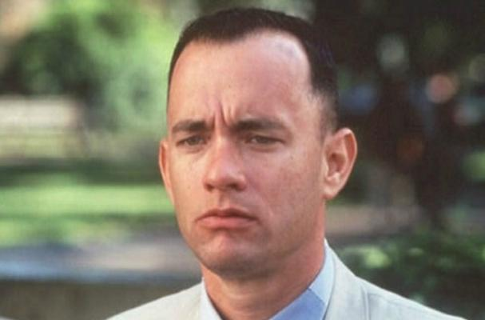
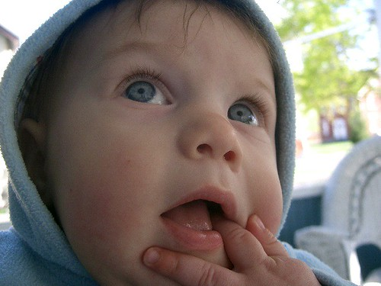
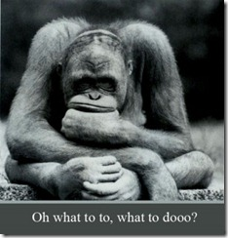
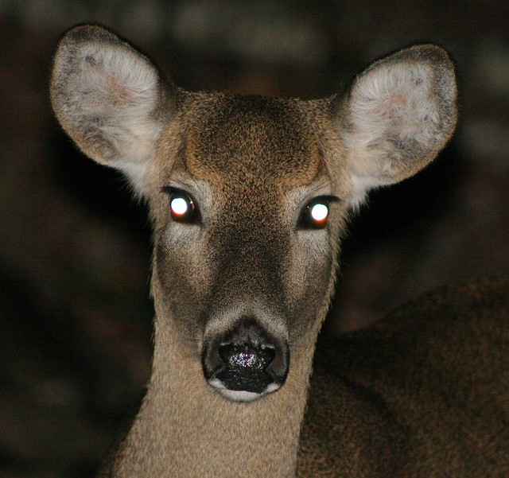
The Current Reality of “Crypto”
Most buyers cannot explain the differences between Government-backed currency and Digital currency
Characteristics
Operational aspects
Pros and Cons
Opportunities
Risks
Types
Amounts
Manageability
Most buyers are simply “Return-seeking” (AKA: “Looking to make a quick buck”)

Slide 13
Basic Crypto Technical Details
The network timestamps transactions by hashing them into an ongoing chain of hash-based proof-of-work, forming a record that cannot be changed without redoing the proof-of-work.
The longest chain not only serves as proof of the sequence of events witnessed, but proof that it came from the largest pool of CPU power.
As long as a majority of CPU power is controlled by nodes that are not cooperating to attack the network, they'll generate the longest chain and outpace attackers.
Source: “Bitcoin: A Peer-to-Peer Electronic Cash System”
(Satoshi Nakamoto – Bitcoin’s anonymous initial investor)

Slide 14
The Two Faces of Crypto
Aspirations
Trends
Unregulated
Individual designs
Anonymity
Privacy
Individuals have the power
Global standardization
Regulation and Centralization
Full transparency
Complete tracking/Accounting
Government controls all
Source: World Economic Forum, Government Summit, March 2022
“Why Governments Must Act Now” (Klaus Schwab)
“Blockchain is the new global accounting” (Dr. Pippa Malmgren)

Slide 15
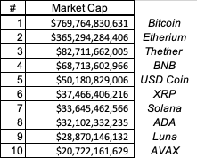
Enter the Players: Top 10 Cryptos
75%
Range:
37x

Slide 16
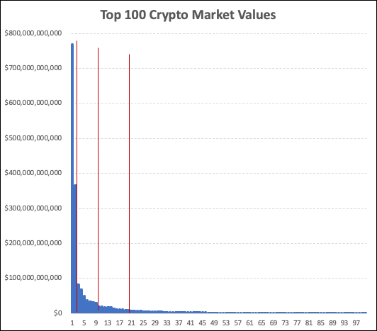
Summary and Insights
A Tale of Whales
and Minnows
Minnows of the 1%

Slide 17
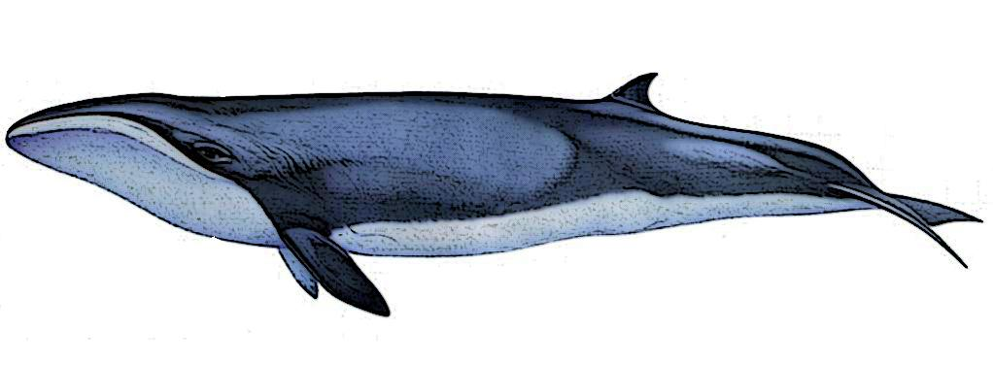
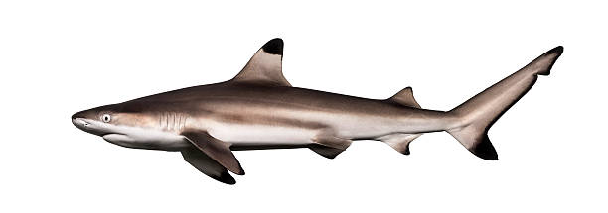
Top 25 Crypto Food Chain (2022)
#1
#2
#3
There are almost 10,000
Cryptocurrencies!
Source: CoinMarketCap.com
#10
#25

Slide 18
Crypto Size Range “Whales and White Noise”
Top 100
Cryptos
The 1%
Cryptos
Group
Largest Crypto is 218x median company size, and…
1,078x smallest in “Crypto Top 100” universe
What about other 9,850 (ridiculously tiny) Cryptos?

Slide 19
S&P 500 vs Crypto Statistics
S&P 500
Top 100 Crypto
Largest stock: 6%
Top 50/500: 54%
Largest to Median: 90x
Net universe: 5,750 (all sizes)
Largest Crypto: 42%
Top 10/100: 82%
Largest to Median: 218x
Net universe: 9,750 (all smaller)

Slide 20
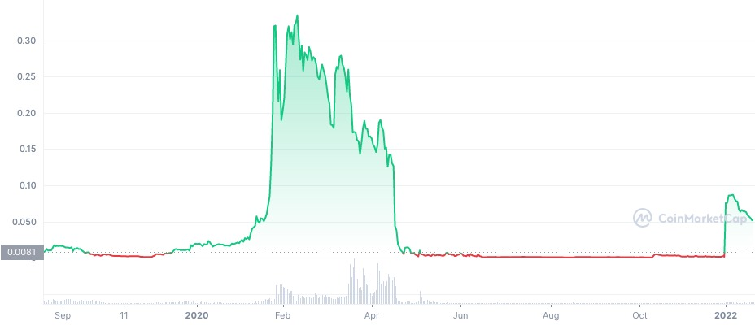
One Crypto Tale (#143)
Elation!
Trend of
Despair…
New Entry Point?
Enter on
Momentum
Total
Despair
Cycle
Repeats?
Data source: CoinMarketCap.com
A Tale of “Anchoring”

Slide 21
Exogenous Risks
Headline Risk
Emotional reactions to “news”
Regulatory reactions
Huge daily gains and losses
Is this an active opportunity?
Is this risk appropriate?
Acquisition Rumors
Target company premium?
Or a disappearing asset?
Musical Chairs?
What if you buy a currency that nobody wants?

Slide 22
Why are you thinking of buying Crypto?
Meet your Transactional Liquidity Needs
Is your current payment system inadequate?
Invest for the long term
How does it fit into your asset allocation?
Do you have capital markets assumptions?
Use it as a tactical/alpha asset
Is this a market timing asset? (Risk on/Risk off)
Is this like venture capital? (Buy the winners)
Who manages this? (Overlay strategy on cash account?)

Slide 23
What is your Crypto Strategy?
How do you justify a crypto purchase?
What is your due diligence process?
Do you have adequate knowledge/experience?
How does this fit into your fiduciary framework?
How do you “sell” this to your board?
What if things “blow up?” Will you see it coming?

Slide 24
How Are You Feeling Now? Which Way Are You Headed?
Let Me
Think
It Over
Maybe I
Should Form
a Committee
Run
Screaming!
Ready to
Recommend!

Slide 25
Stephen Campisi, CFA
Managing Director
The Pensar Group
860.214.7504
www.thepensargrp.com
pensargrp@gmail.com
stevecampisicfa@comcast.net

